Slide 1
Use of LogBB data to model and predict small molecule Blood Brain Barrier Penetrance
Caiden Lukan | PharmD candidate
Data Science Intern
Mentor: Amanda Paulson
Butler University
2021 ATOM internship symposium | July 30th, 2021

Slide 2
Project Overview

Slide 3
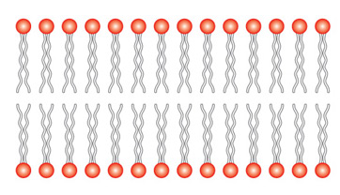
What is the Blood Brain Barrier?
A barrier between the CNS and the rest of the body that prevents certain molecules from causing CNS damage
Brain
Blood
Notes:
Why is this important and what other aspects can this be used for

Slide 4
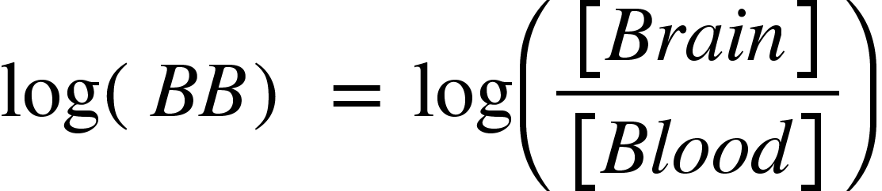
What is logBB?
logBB
The ratio of the concentration of a certain compound in the brain to the concentration of the compound in the blood at steady state
Best for concentrations at equilibrium
Notes:
Explain in a more biological perspective

Slide 5
How will LogBB data be used
LogBB data will be used as a metric for a regression and classification model
The classification model will have a LogBB threshold of 0 to determine if a molecule passes
LogBB < 0 means that a molecule does not pass the BBB.
LogBB ≥ 0 means that a molecule passes the BBB.
Notes:
We know that this is not 100 percent true, but this is the one that we chose. People use different thresholds because it is not a perfect correlation.

Slide 6
Material, Methods, Data Curation

Slide 7
Materials, Methods, and Data Curation
In Vitro (PAMPA and IAM) and In Vivo (mouse)
Collected 2590 compounds from 7 different sources.
Converted Compounds to base_rdkit_smiles to look for duplicate compounds.
Removed duplicate compounds to have a final total of 1181 compounds.
Merged and Averaged LogBB values
Standard Deviation = 2

Slide 8
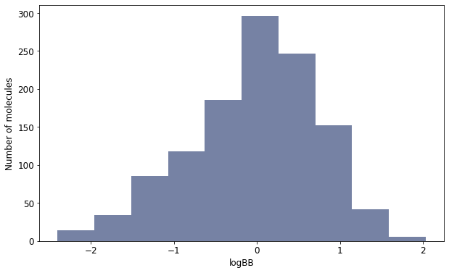
Distribution of logBB values

Slide 9
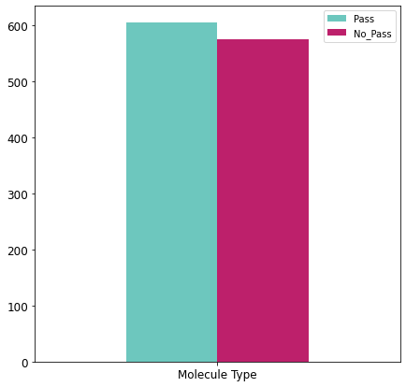
Distribution of molecules that do and do not pass the BBB
605
576

Slide 10
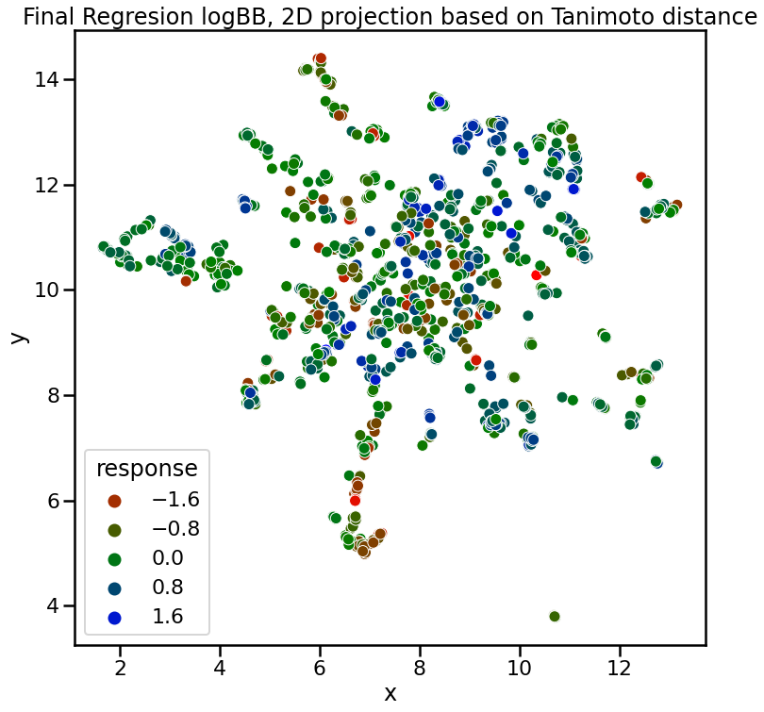
Final regression logBB, 2D projection based on tanimoto distance

Slide 11
Data Modelling

Slide 12
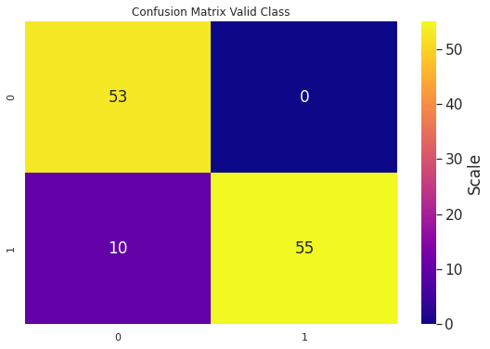
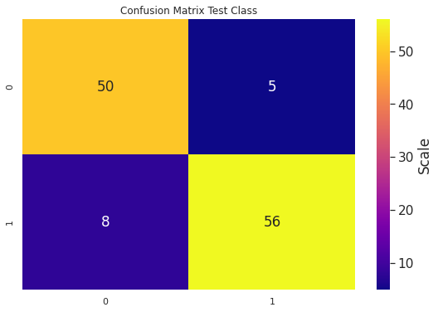
Classification NN featurized by Rdkit inferencing
Validation Set
Test Set
AUC_ROC = 0.94
AUC_ROC = 0.83
Notes:
Models featurized by ECFP tended to have the worst performance for both classification and regression
Molecules that were predicted incorrectly for the classification model have a LogBB close to 0
Point out as explaining it and eliminate the slide

Slide 13
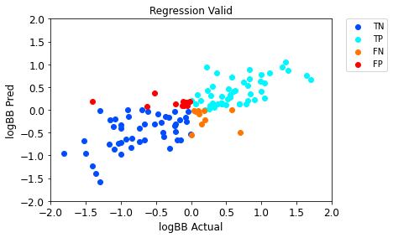
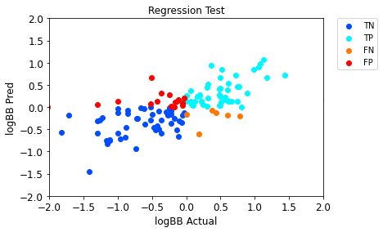
Regression NN featurized by rdkit inferencing
R2 = .61
ROC_AUC = .83
R2 = .43
ROC_AUC = .82

Slide 14
Data Exploration
Metadata analysis

Slide 15
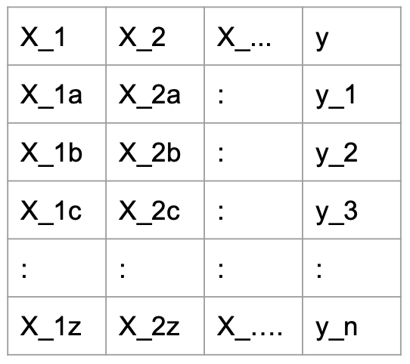
Feature importance
Accomplished by shuffling the values of the features individually
Poor scores reflect increased importance of said feature
Notes:
Know what part of the molecule may play a larger role in the mechanism of action
My algorithm can work for all model types featurized by Graph Conv, MOE, Mordred, and Rdkit
Why do we want to explore this feature
How does it work
What am I contributing
pixelation
For this slide here are some points / language to be explicit about what you're doing here:
1) Why do we want to explore feature importance?
Once I had my best models trained, I wanted to further explore what chemical features contribute to making a molecule pass or not pass the blood brain barrier. To do this, I analyzed feature importance using the permutation method.
2) How does it work?
for each feature, I randomly shuffled the values and used that new dataframe with a single shuffled feature as input to the model for new predictions. Then I recalculated the performance metrics to analyze how much worse the model performed after losing the information from that feature. We assume that the features that elicited the largest decrease in performance metrics were the most important for the model to determine the molecule's structure activity relationship.
3) What are you contributing?
The nice thing about the permutation method is that it can be applied to any model type and almost any feature set. I implemented this algorithm to work with AMPL models and created a module that I am hoping to contribute to the AMPL code base.

Slide 16
What was the process
X_1 | X_2 | X_... | y
X_1a | X_2a | : | y_1
X_1b | X_2b | : | y_2
X_1c | X_2c | : | y_3
: | : | : | :
X_1z | X_2z | X_…. | y_n
X_1 | X_2 | X_... | y
X_1f | X_2a | : | y_1?
X_1p | X_2b | : | y_2?
X_1r | X_2c | : | y_3?
: | : | : | :
X_1b | X_2z | X_…. | y_n?
X_1 | X_2 | X_... | y
X_1a | X_2g | : | y_1?
X_1b | X_2e | : | y_2?
X_1c | X_2s | : | y_3?
: | : | : | :
X_1z | X_2q | X_…. | y_n?
Notes:
X_1 = MW
X_2 = HBD

Slide 17
What was the process
X_1 | X_2 | X_... | y
600 | 6 | : : | 0
155 | 3 | : : | 1
: : | : : | : : | : :
X_1 | X_2 | X_... | y
21 | 6 | : : | 1
500 | 3 | : : | 1
: : | : : | : : | : :
X_1 | X_2 | X_... | y
600 | 4 | : : | 0
155 | 12 | : : | 0
: : | : : | : : | : :
Notes:
X_1 = MW
X_2 = HBD

Slide 18
Feature Importance Classification
The Partial Equalization of Orbital Electronegativities (PEOE_VSA6)
# Ketone groups (fr_ketone_Toplis)
MaxAbsPartialCharge
# Guanidino Groups(fr_guanidino)
# Thiazole Groups (fr_thiazole)

Slide 19
Feature Importance Regression
Quantitative Estimation of Drug-Likeness (Qed)
Topological Polar Surface Area (TPSA)
The Partial Equalization of Orbital Electronegativities (PEOE_VSA6)
# Carboxylate groups (fr_COO)
MaxAbsPartialCharge

Slide 20
What is PEOE and what does this mean?
The parameters PEOE is dependent on is “partial charge and van der Waals surface area”
Biologically and chemically, a change in PEOE would change the polarity of the molecule, which would then cause a decreased ability to pass the Blood Brain Barrier
Notes:
What does this mean to the molecules

Slide 21
What is Qed and what does this mean?
Reflects the underlying distribution of molecular properties including:
Molecular Weight
LogP
Topological Surface Area
Number HBD and HBA
Aromatic Rings
Rotatable bonds
Presence of unwanted chemical features
Biologically and Chemically, Qed is very similar to the parameters in Lipinski's rule of 5

Slide 22
Final Remarks

Slide 23
Future Direction
Add more LogBB data to the current data that is published
Make the best models available to the public
Compare with effectiveness with Molecular Dynamic models
Add my feature importance code to AMPL

Slide 24
Acknowledgements
I would first like to thank Amanda Paulson for all of her work for pushing me to further look at my data in ways that have never been done before.
I would like to next thank Da Shi for his help with looking at some of my coding errors as well as suggesting strategies to make my code efficient.
I would like to thank Ravi for his support with understanding how to use docking software for my own interest.
I would like to thank Professor Class for his work in the python bootcamp.
Finally, I would like to thank to thank the rest of the interns for supporting me through this project.

Slide 25
Sources
Radchenko EV, Dyabina AS, Palyulin VA. Towards Deep Neural Network Models for the Prediction of the Blood–Brain Barrier Permeability for Diverse Organic Compounds. Molecules. 2020; 25(24):5901. https://doi.org/10.3390/molecules25245901
Shin HY, Lee S, Oh H, Yoo S, Kim W, Kang M. Development of blood brain barrier permeation prediction models for organic and inorganic biocidal active substances. Chemosphere. 2021; 277: 130330. https://doi.org/10.1016/j.chemosphere.2021.130330
Vilar S, Chakrabarti M, Costanzi S. Prediction of passive blood-brain partitioning: Straightforward and effective classification models based on in silico derived physicochemical descriptors. J. Mol. Graph. 2010; 28(8): 899. https://doi.org/10.1016/j.jmgm.2010.03.010
Zhang L, Zhu H, Oprea TI, Golbraikh A, Tropsha A. QSAR modeling of the blood-brain barrier permeability for diverse organic compounds. Pharm Res. 2008;25(8):1902-1914. doi:10.1007/s11095-008-9609-0
Plisson F, Piggott AM. Predicting Blood–Brain Barrier Permeability of Marine-Derived Kinase Inhibitors Using Ensemble Classifiers Reveals Potential Hits for Neurodegenerative Disorders. Marine Drugs. 2019; 17(2):81. https://doi.org/10.3390/md17020081
Zhu, L., Zhao, J., Zhang, Y. et al. ADME properties evaluation in drug discovery: in silico prediction of blood–brain partitioning.Mol Divers 22, 979–990 (2018). https://doi.org/10.1007/s11030-018-9866-8
Cerliani M. Feature Importance with Neural Network. Medium. https://towardsdatascience.com/feature-importance-with-neural-network-346eb6205743. Published January 21, 2020. Accessed July 13, 2021.

